Slide 1
Understanding verbs
GET
PUT
POST
DELETE
PATCH
Remember consistency!
@schneidenbach

Slide 2

Don’t mutate data with GETs.
@schneidenbach

Slide 3
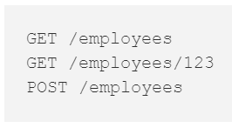
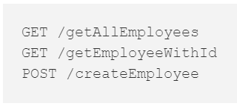

Resource identification
Nouns vs. verbs
Basically, use plural nouns
@schneidenbach

Slide 4
Good HTTP Codes
200 OK
404 Not Found
401 Unauthorized
(aka not authenticated)
403 Forbidden
(aka you can’t do that)
@schneidenbach

Slide 5
GET considerations
Sorting
Filtering
Paging
@schneidenbach

Slide 6
Sorting
GET /customers?orderBy=name
@schneidenbach

Slide 7
Filtering
GET /customers?name=Spencer
@schneidenbach

Slide 8
Paging
GET /customers? page=1 & pageSize=1000
{
"pageNumber": 1,
"results": [...],
"nextPage": "/customers?page=2"
}
@schneidenbach

Slide 9
Do I need to sort/page/filter?
Maybe!
What do your consumers need?
@schneidenbach

